Slide 1
Project 4:
Telco Customer Churn
Contributors: John, Ken, Nick, Zalak

Slide 2
Project Overview
Predicting customer churn is critical for telecommunication companies
Large telecom companies are seeking to develop models to predict which customer are more likely to change
Goal - Build a model to predict how likely a customer will churn by analysing its characteristics
A basic machine learning pipeline is
Database has created for Data exploration and Tableau is used for data visualization

Slide 3
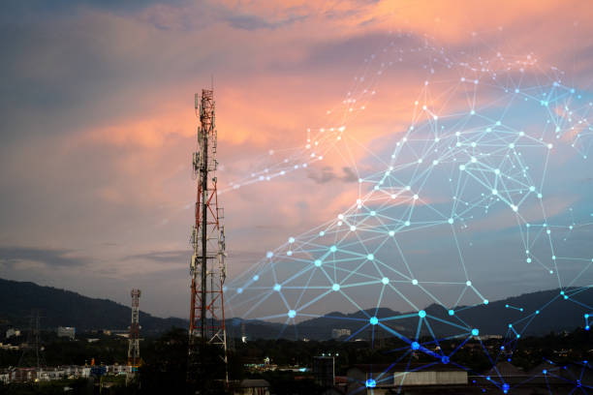
Telco Industry
Estimated revenue of the industry was $589.9 billion in 2022 in the US
More than 10,000 Telco companies within the US
Key is to attract new customer and avoid contract terminations(=churn) to grow their revenue
Customer churn prediction is an important factor for Telco Industry
Telcos apply different types of Churn Analytics and machine learning models to predict customer churn
Churn rate = (no. of customers lost during a time frame / no. of customers at the beginning of the time frame) *100

Slide 4
Data Source
Telco Churn Dataset from Kaggle.com
(https://www.kaggle.com/blastchar/telco-customer-churn)
Created by IBM Sample Team
Original dataset : Total of 61 attributes, 7043 records, Separated across 5 files
Kaggle dataset: Total of 21 attributes, 7043 records, 1 file
Target variable: Churn - Binary

Slide 5
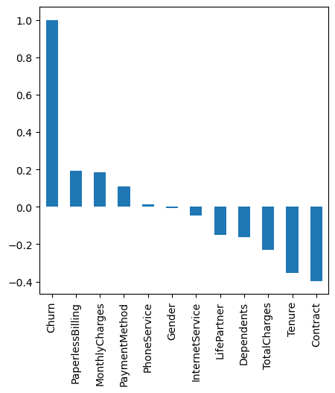
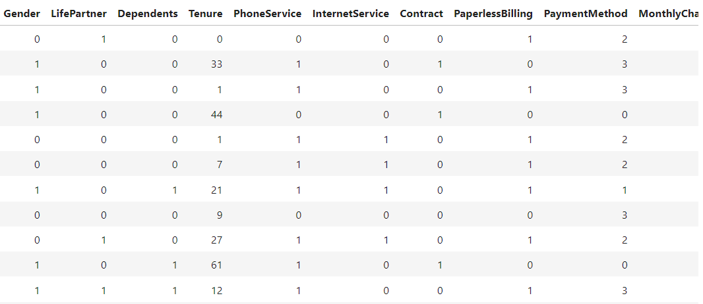
Data Preparation
Data Reading
Exploratory Data Analysis and Data Cleaning
Feature Engineering

Slide 6
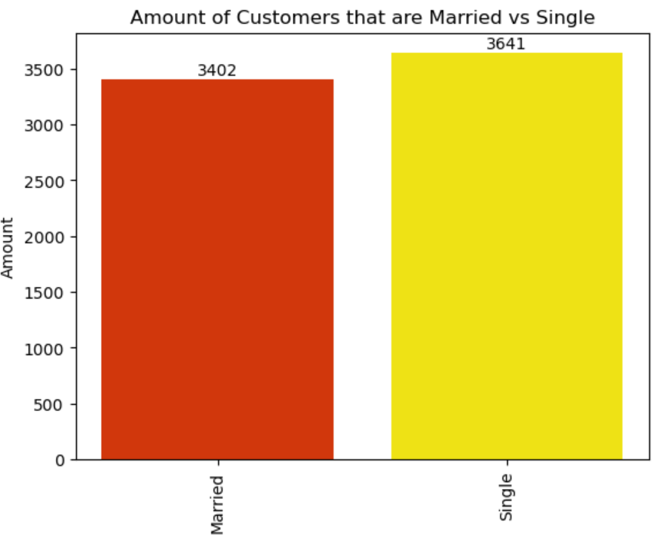
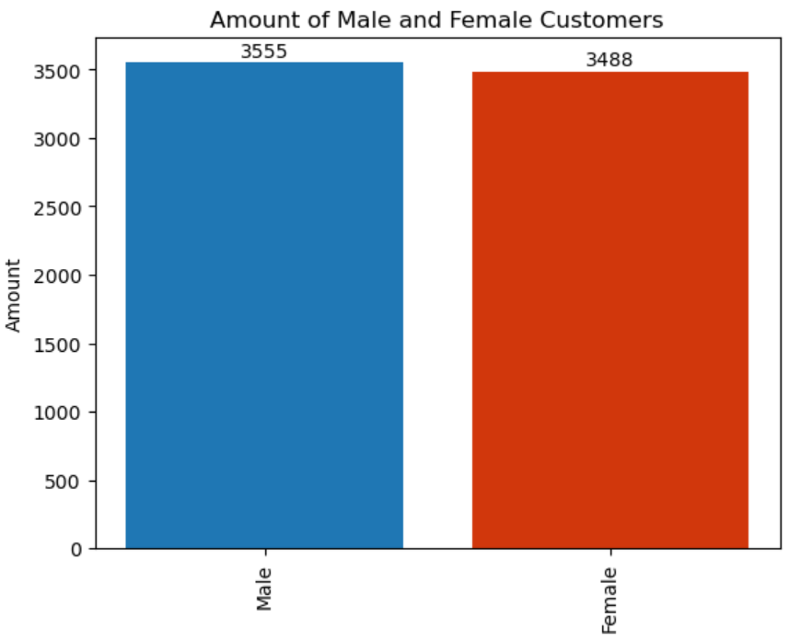
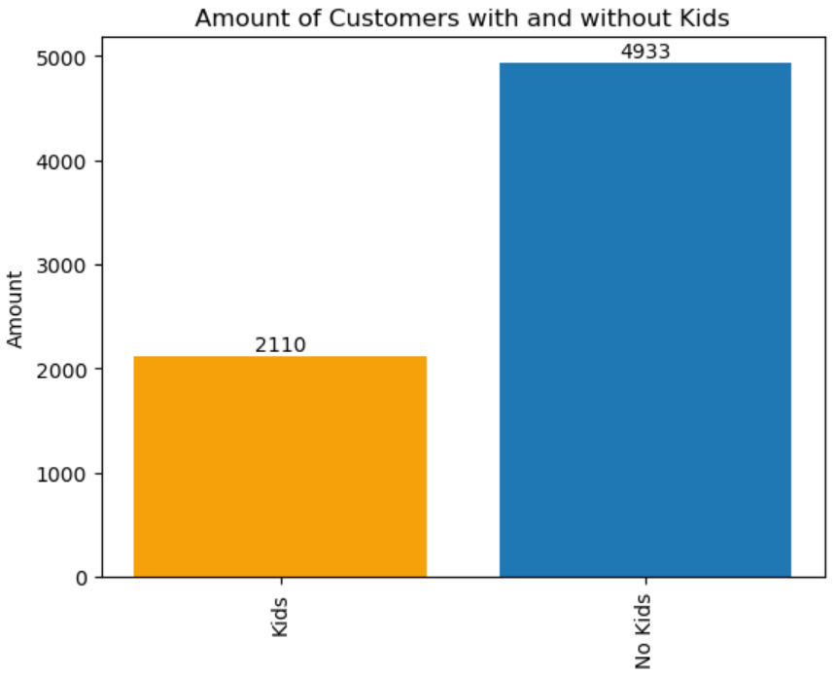
Customer Analysis

Slide 7
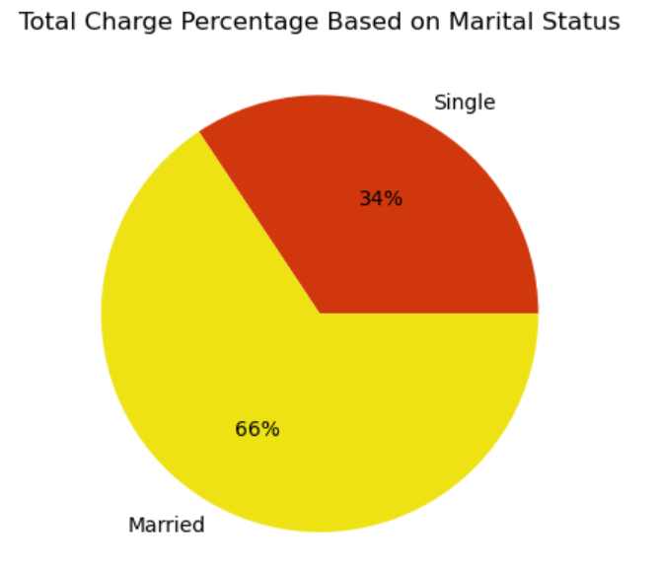
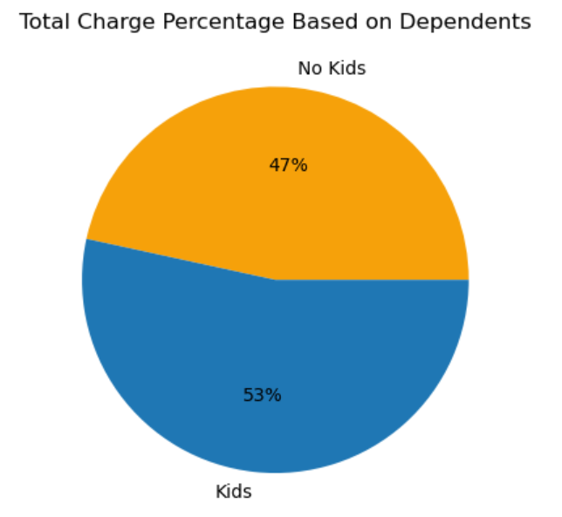

Slide 8
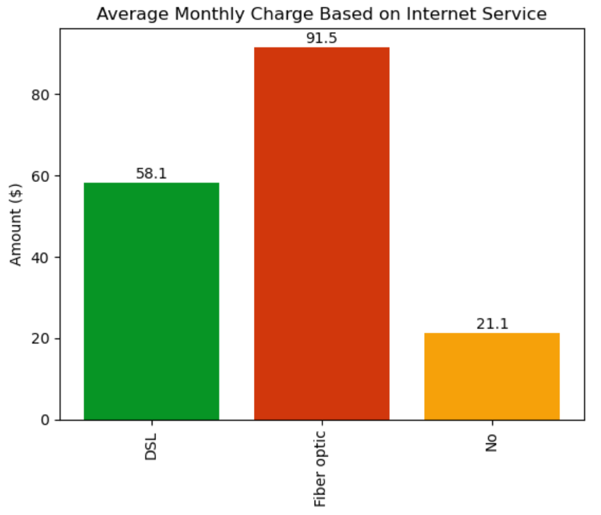
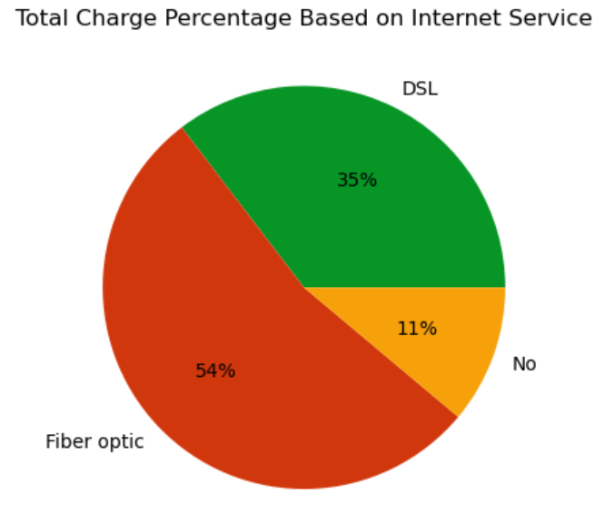
Internet Service Analysis

Slide 9
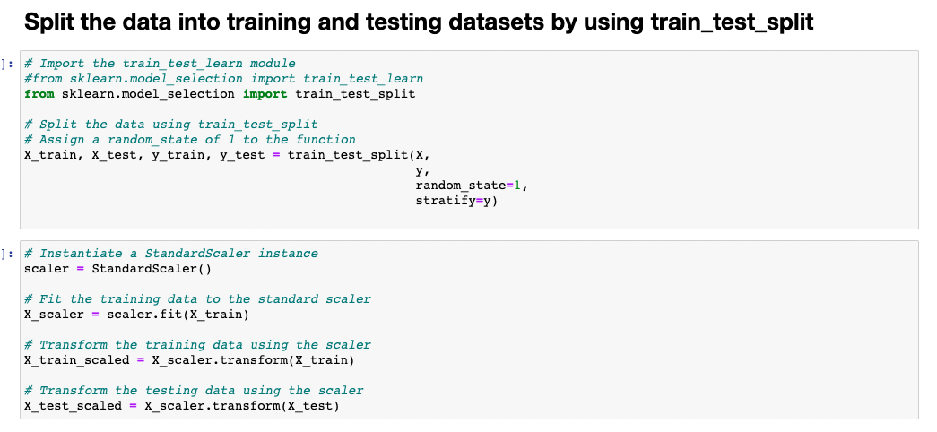
Split the data into training

Slide 10
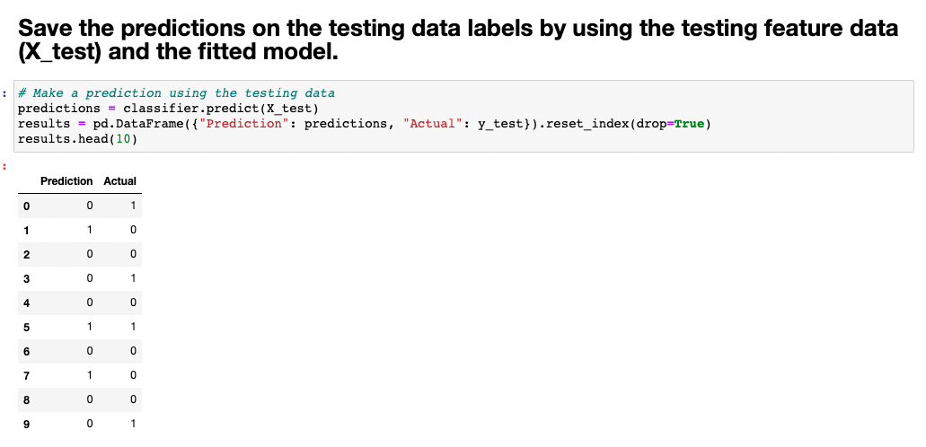
Prediction

Slide 11
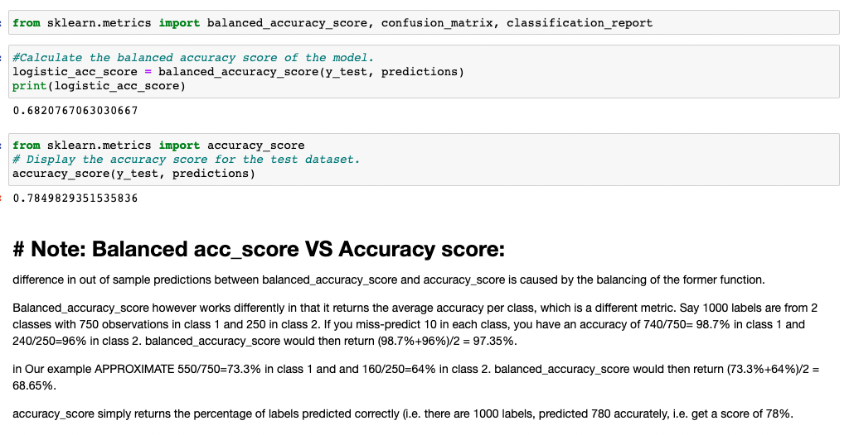
Balanced acc_score VS Accuracy score

Slide 12
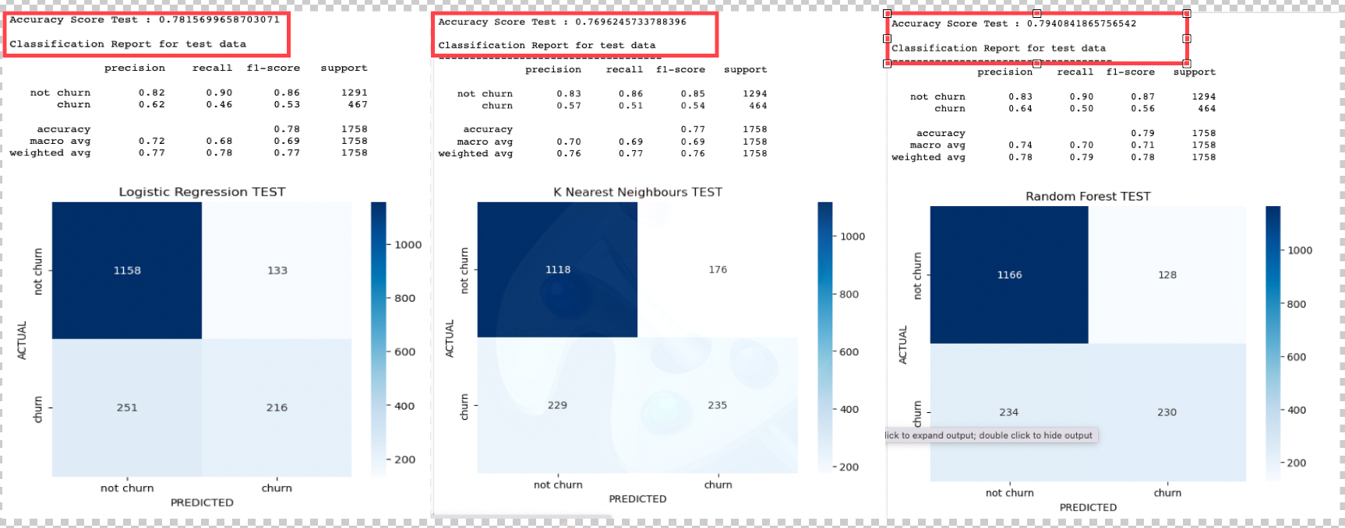
Regression, KNN ,Random forest
models comparision.

Slide 13
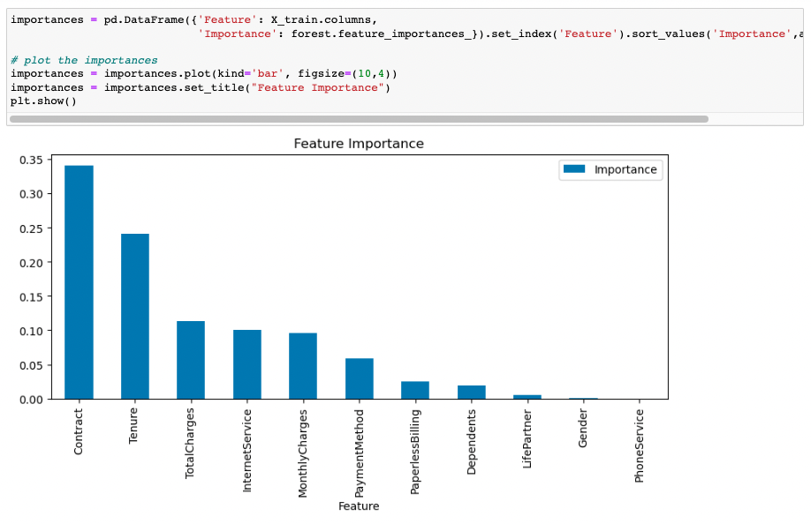
Sklearn feature importance is a way of measuring how much a model depends on a feature

Slide 14
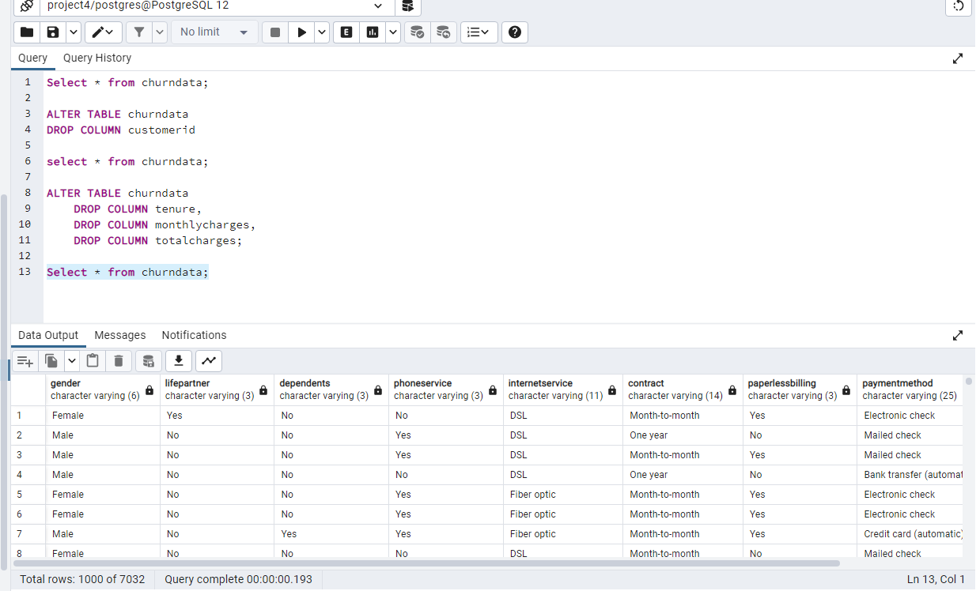
Dropping Columns and Creating SQL Database

Slide 15
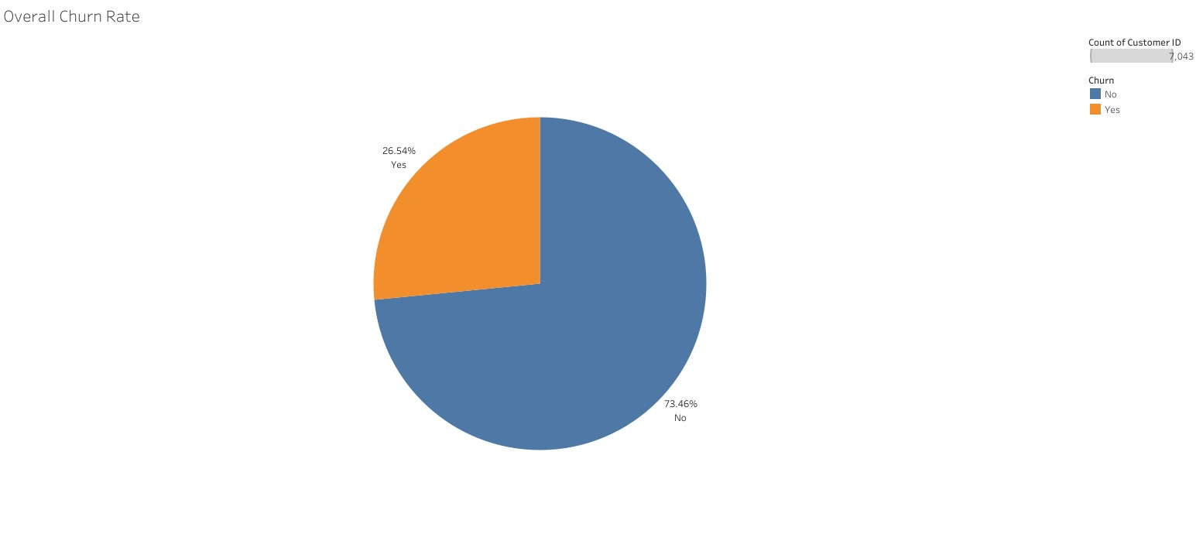
Ove

Slide 16
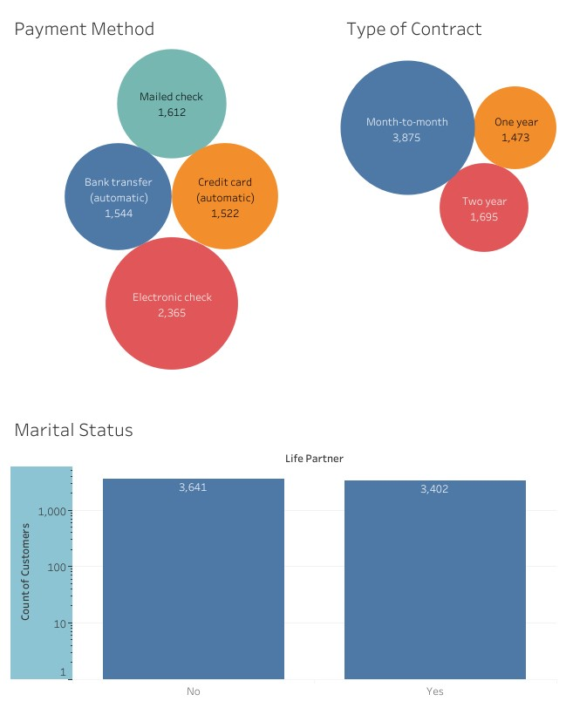

Slide 17
Thank you!

